Slide 1
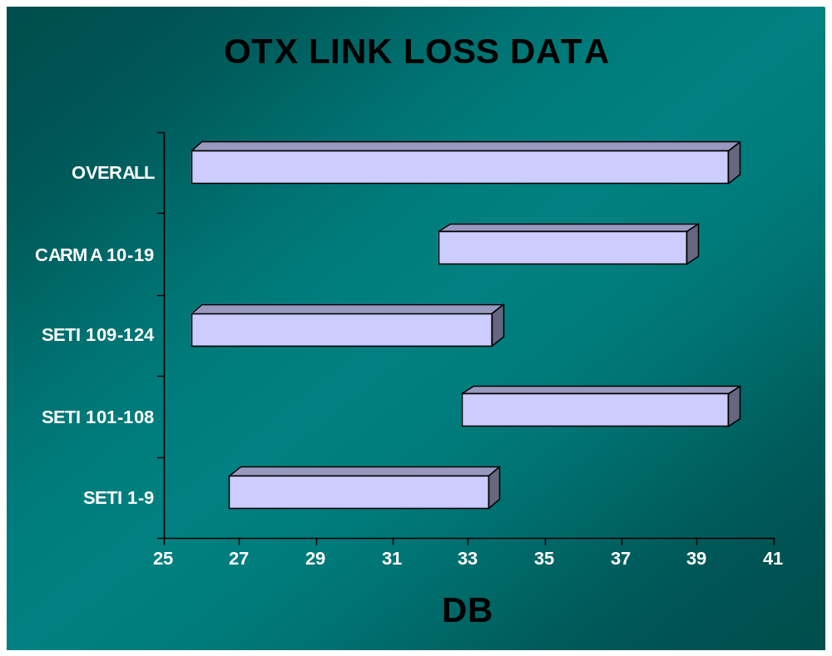
ORDER OF SHIPMENTS
3
4
2
1

